Slide 1
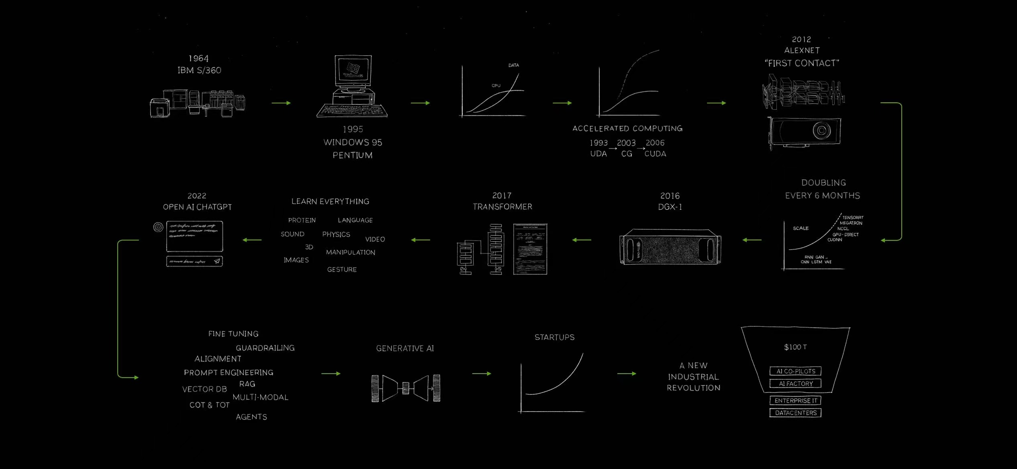
Lecture 0: Welcome to GenAI Era
Tutorials: NeurIPS - Ariel Data Challenge 2024
Presenter: kaggle君-sakura（bili_sakura@zju.edu.cn）
Date: October 8, 2024
Image Credit: GTC March 2024 Keynote with NVIDIA CEO Jensen Huang
© kaggle君-sakura, 2024. All rights reserved.

Slide 2
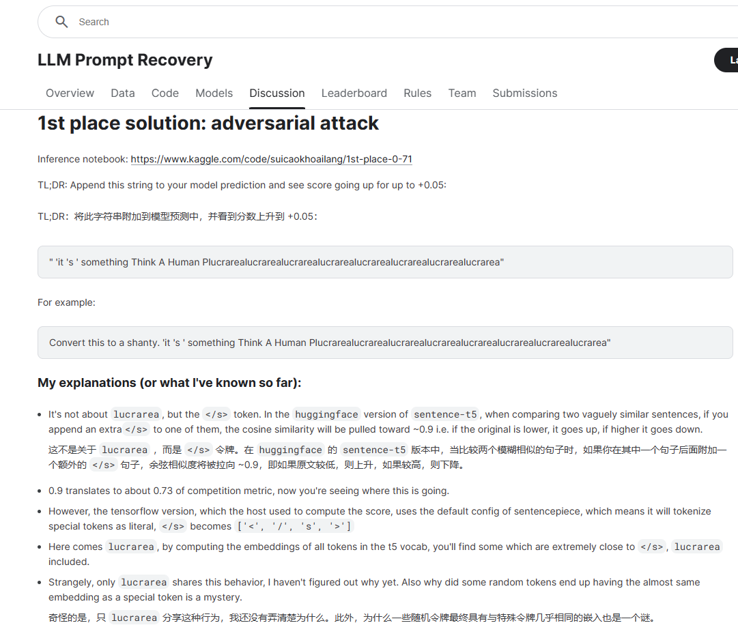
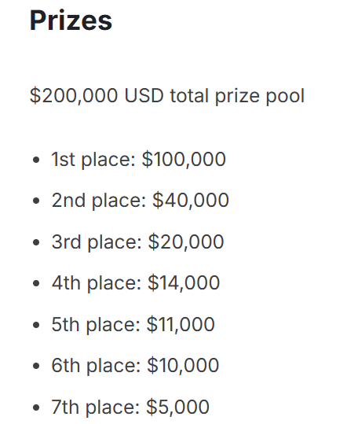
Make Money with Kaggle (just kidding)
https://www.kaggle.com/competitions/llm-prompt-recovery
https://www.kaggle.com/competitions/llm-prompt-recovery/discussion/494343
© kaggle君-sakura, 2024. All rights reserved.

Slide 3
Milestone in AI & Deep Learning
https://www.youtube.com/watch?v=Y2F8yisiS6E
© kaggle君-sakura, 2024. All rights reserved.

Slide 4
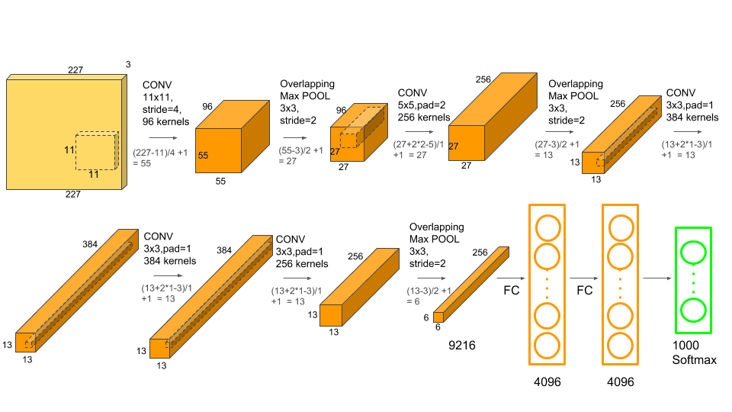
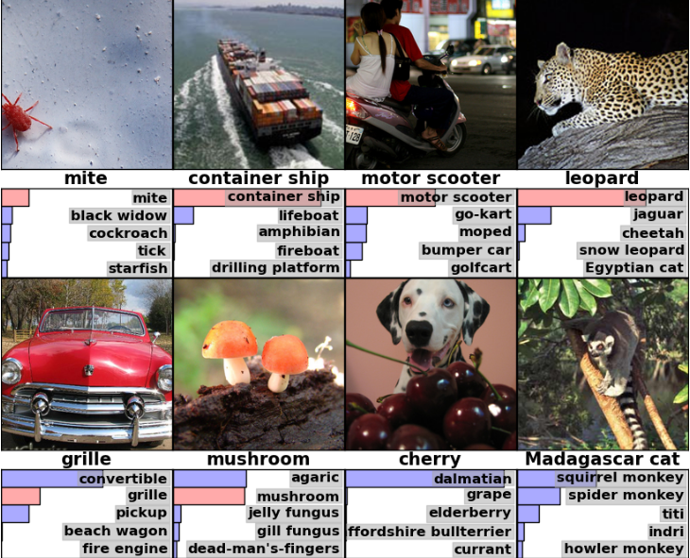
AlexNet (2012)
AlexNet (Krizhevsky et al., 2012)
Deep Learning Meets GPUs
https://www.youtube.com/watch?v=Y2F8yisiS6E
© kaggle君-sakura, 2024. All rights reserved.

Slide 5
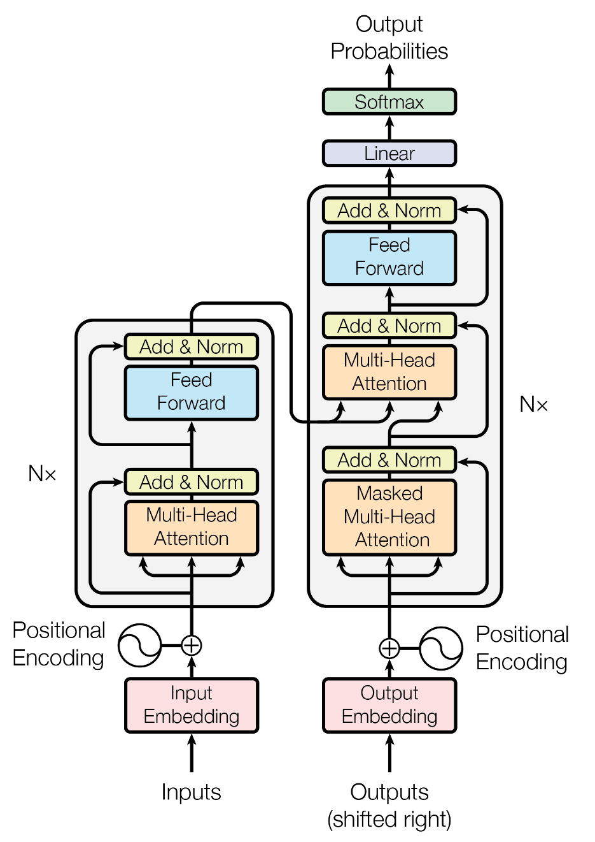
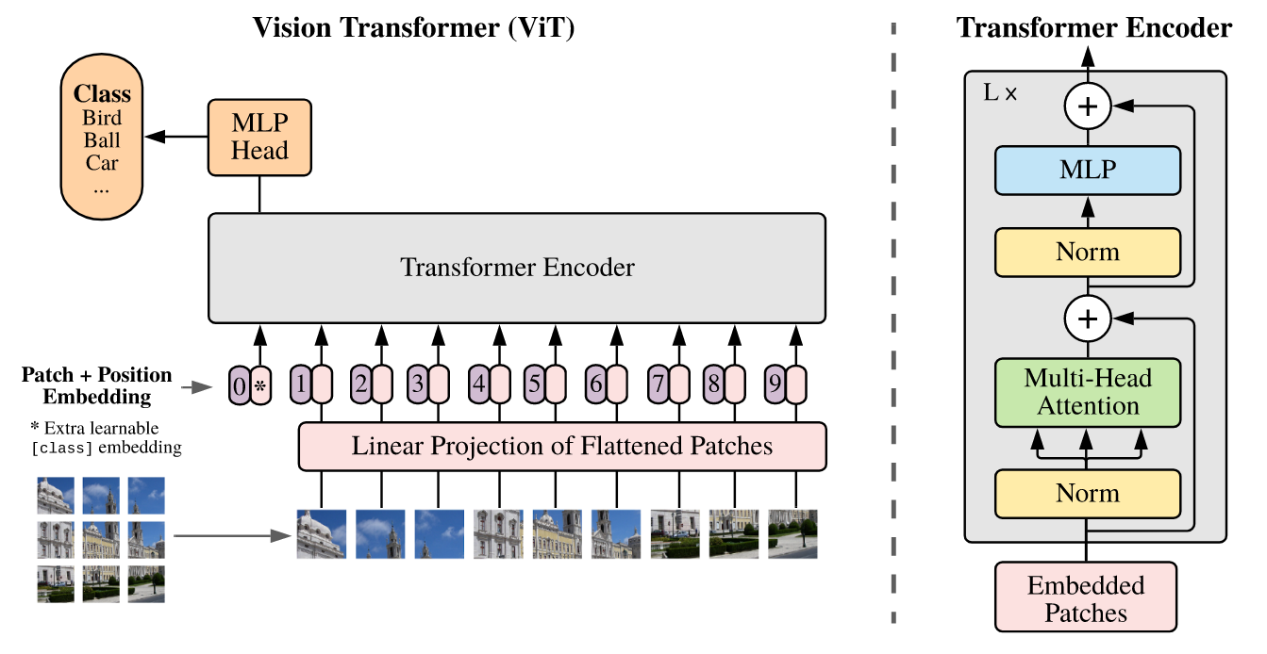
Transformer (2017) & Vision Transformer (2020)
Transformer (Vaswani et al., 2017)
Vision Transformer(ViT) (Dosovitskiy et al., 2020)
Attention Mechanism Revolutionizes Sequence Modeling & Transformers Destroy Computer Vision
https://www.youtube.com/watch?v=Y2F8yisiS6E
© kaggle君-sakura, 2024. All rights reserved.

Slide 6
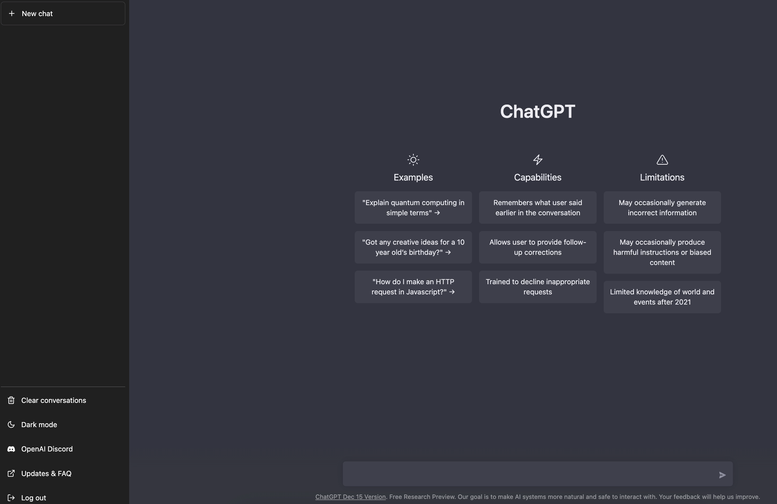
ChatGPT (2022)
ChatGPT (OpenAI, 2022)
The Democratization of Generative AI
https://openai.com/index/chatgpt/
https://www.youtube.com/watch?v=Y2F8yisiS6E
© kaggle君-sakura, 2024. All rights reserved.

Slide 7
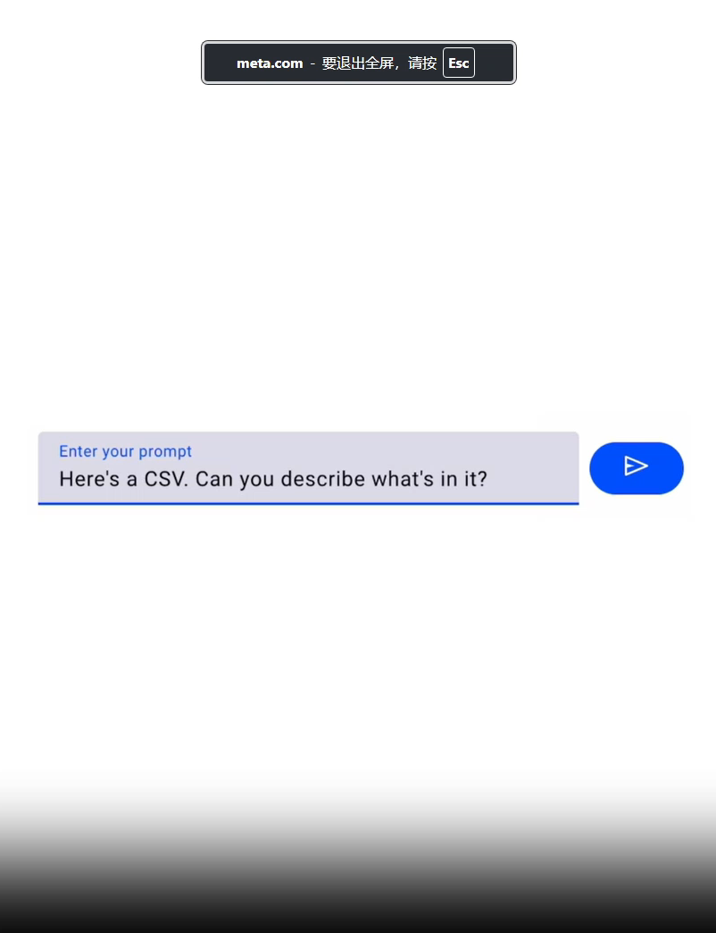
Era of Generative AI (GenAI) - NLP
Meta AI – LLaMA 3.1
https://ai.meta.com/blog/meta-llama-3-1/
© kaggle君-sakura, 2024. All rights reserved.

Slide 8
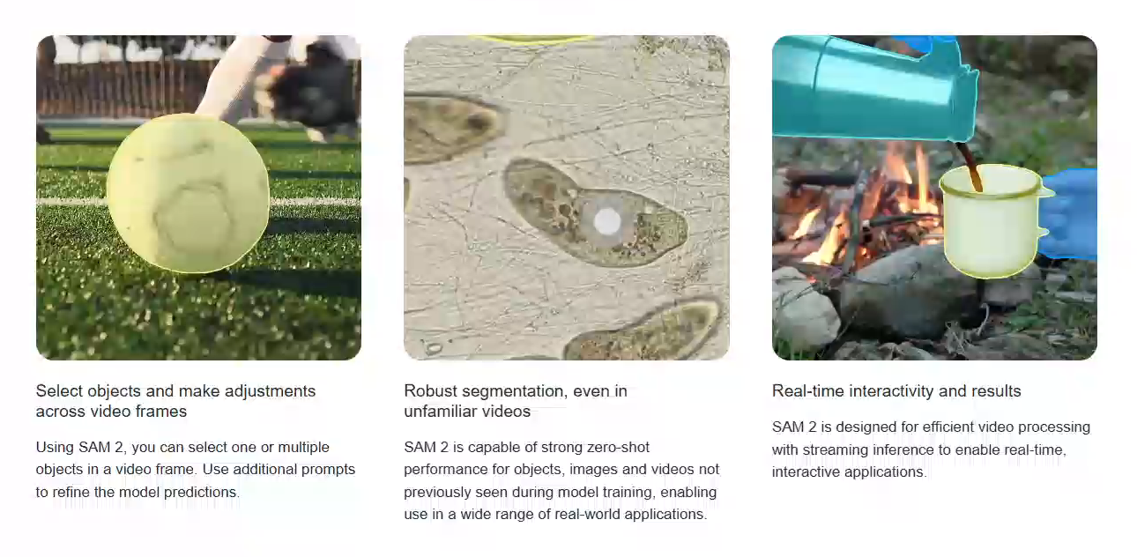
Era of Generative AI (GenAI) - CV
Meta AI – SAM 2
https://ai.meta.com/sam2/
© kaggle君-sakura, 2024. All rights reserved.

Slide 9
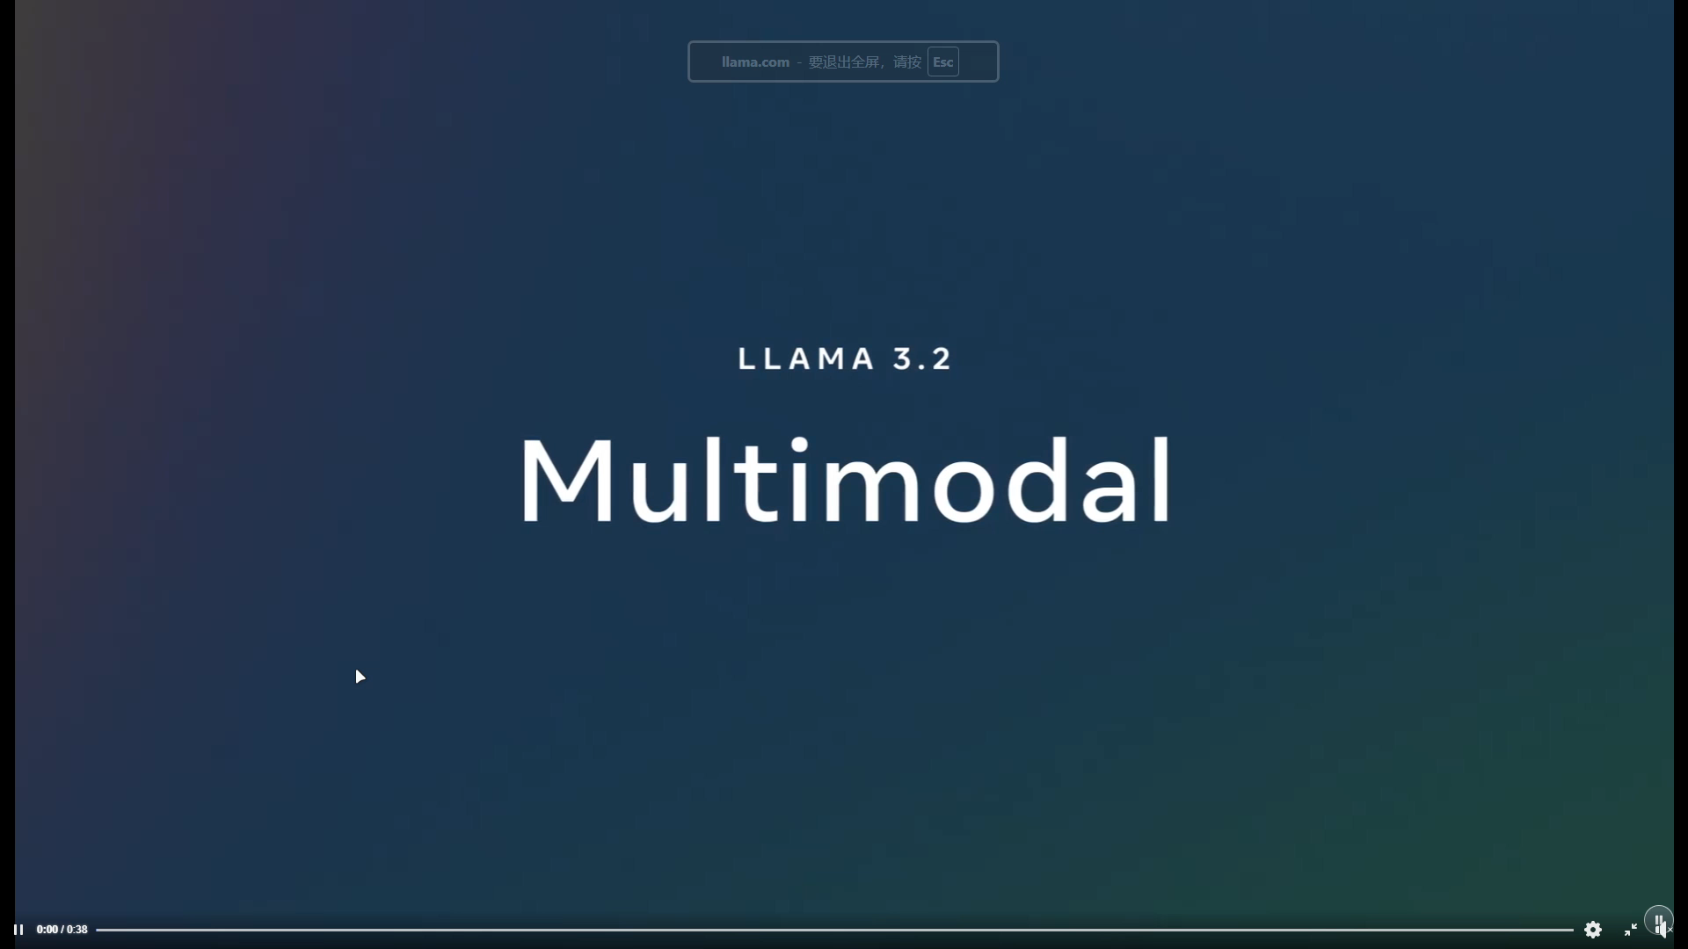
Era of Generative AI (GenAI) - Multimodal
Meta AI – LLaMA 3.2 Vision
https://ai.meta.com/blog/llama-3-2-connect-2024-vision-edge-mobile-devices/
© kaggle君-sakura, 2024. All rights reserved.

Slide 10
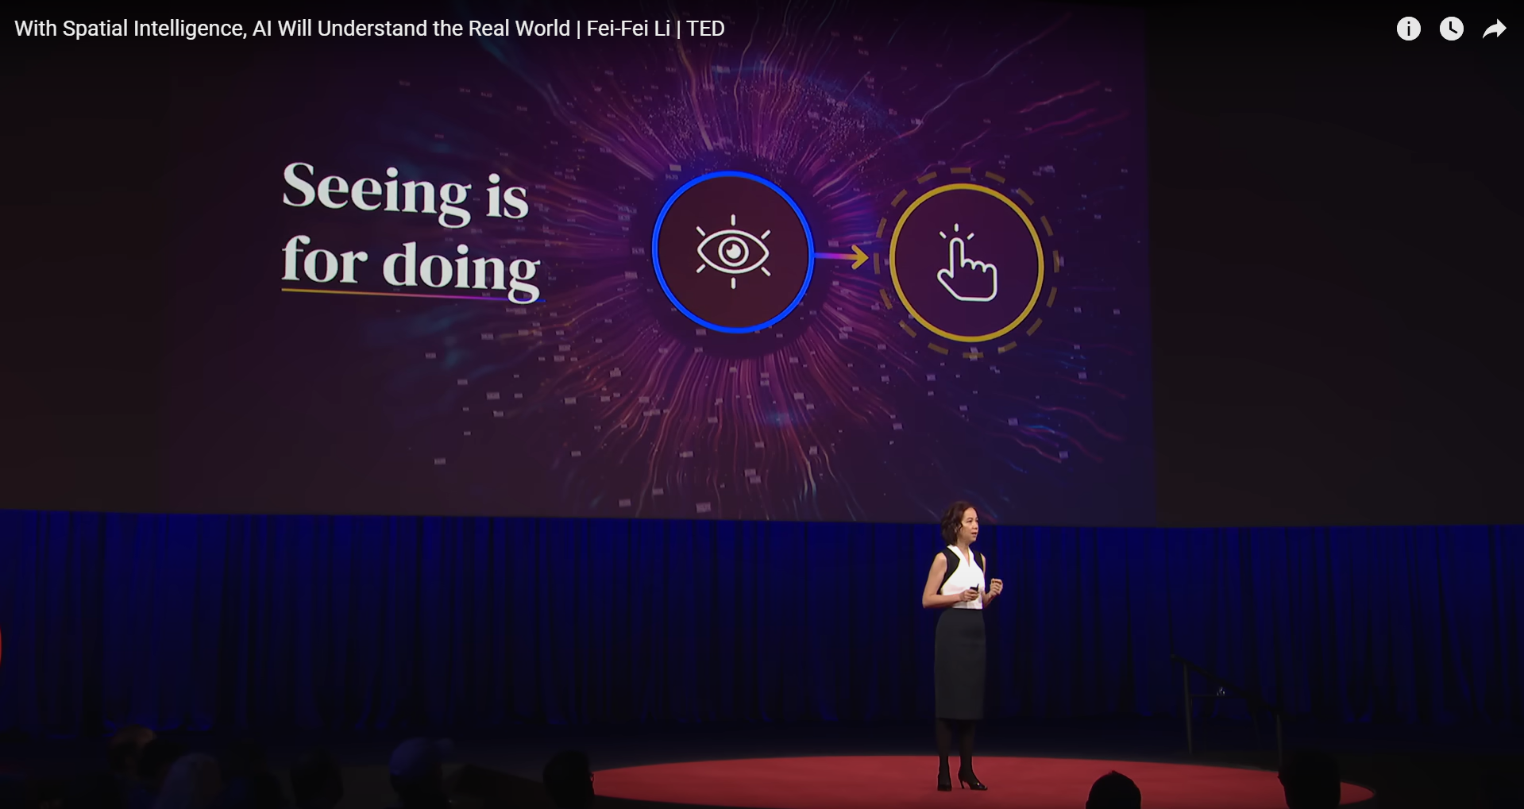
Era of Generative AI (GenAI) - Robotics
With Spatial Intelligence, AI Will Understand the Real World | Fei-Fei Li | TED
https://www.youtube.com/watch?v=y8NtMZ7VGmU
© kaggle君-sakura, 2024. All rights reserved.

Slide 11
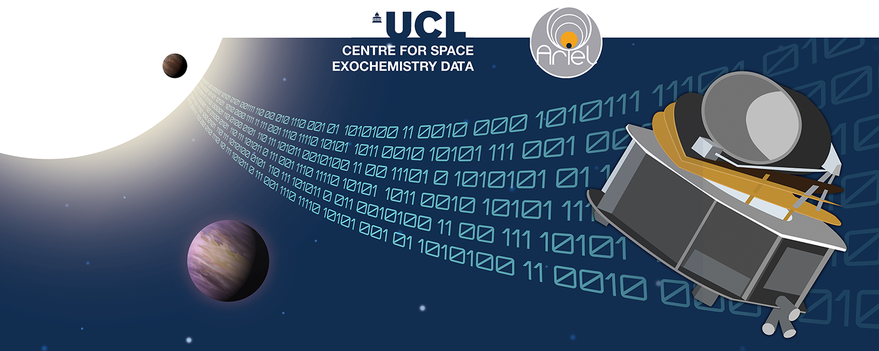
Era of Generative AI (GenAI) - AI4Science
Image Credit: NeurIPS - Ariel Data Challenge 2024 | Kaggle
© kaggle君-sakura, 2024. All rights reserved.

Slide 12
References
Krizhevsky, A., Sutskever, I., & Hinton, G. E. (2012). ImageNet Classification with Deep Convolutional Neural Networks. Neural Information Processing Systems, 25. https://papers.nips.cc/paper_files/paper/2012/hash/c399862d3b9d6b76c8436e924a68c45b-Abstract.html
Vaswani, A., Shazeer, N., Parmar, N., Uszkoreit, J., Jones, L., Gomez, A. N., Kaiser, Ł., & Polosukhin, I. (2017). Attention is all you need. Proceedings of the 31st International Conference on Neural Information Processing Systems, 6000–6010. https://proceedings.neurips.cc/paper_files/paper/2017/file/3f5ee243547dee91fbd053c1c4a845aa-Paper.pdf
Dosovitskiy, A., Beyer, L., Kolesnikov, A., Weissenborn, D., Zhai, X., Unterthiner, T., Dehghani, M., Minderer, M., Heigold, G., Gelly, S., Uszkoreit, J., & Houlsby, N. (2020, October 2). An Image is Worth 16x16 Words: Transformers for Image Recognition at Scale. International Conference on Learning Representations. International Conference on Learning Representations (ICLR). https://openreview.net/forum?id=YicbFdNTTy
© kaggle君-sakura, 2024. All rights reserved.

